Slide 1
Wireless Technologies in IoT
Subtitle

Slide 2
Title and Content Layout with List
Add your first bullet point here
Add your second bullet point here
Add your third bullet point here

Slide 3
ZigBee
Definition
Architecture and Design
Low-power wireless communication protocol designed for sensor networks, monitoring, and automation. Based on IEEE 802.15.4
Star, tree, mesh network topologies
2.4GHz
Low data rates, suitable for small sensor messages
AES-128 encryption
Main Components
Applications
Coordinator: creates and manages the network
Router: Forwards data between devices
End Device: Collects Data or performs actions, often using a battery
Smart lighting and thermostats
Motion and door sensors
Smart energy meters
Building autmation

Slide 4
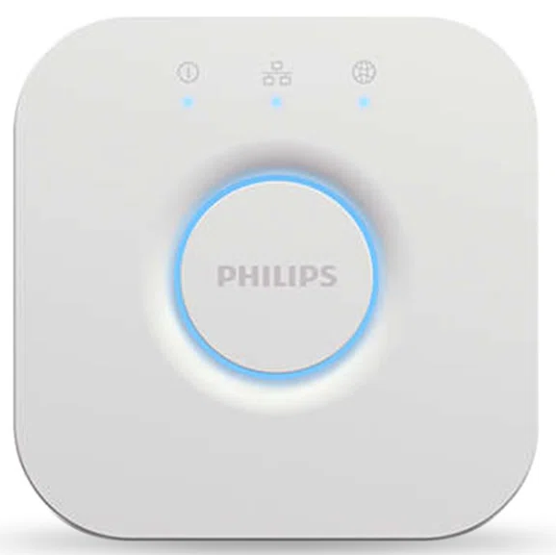
ZigBee (Cont’d)
Pros and Cons
Company and Product example
Pros
Low power consumption and long battery life
Mesh networking (extends range)
Supports many devices in one network
Large ecosystem of compatible products
Cons
Limited bandwidth compared to Wi-Fi and mobile data
2.4 GHz Interference
Compatibility depends on the product profile and supported features
Company: Signify / Philips Hue
Product: Philips Hue Bridge
  Connects compatible smart lights using ZigBee
  Connects the lighting system to a home network
  Supports lighting automation and app-based control
  Supports up to 50 bulbs on the standard Bridge

Slide 5
Z-Wave
Definition
Architecture and Design
Wireless communications protocol used primarily for home automation
Mesh Network
Regional sub-GHz frequency bands
Avoids 2.4GHz interference compared to Wi-Fi and ZigBee
Main Components
Applications
Controller: Network Administrator
Routing Nodes: Extensions
End Nodes: End Devices
Smart door locks and alarms
Home Lighting and switches
Temperature and environmental sensors
Energy management

Slide 6
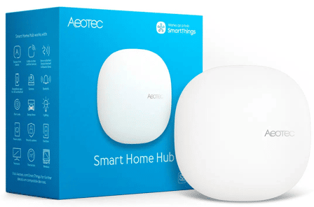
Z-Wave (Cont’d)
Pros and Cons
Company and Product example
Pros
Lower power for battery devices
Sub-Ghz range
Mesh Networking
Two-way Feedback between devices
Interoperability
Cons
Higher Device Costs
Smaller Device Selection
Regional Frequency differences
Company: Aeotec
Product: Aeotec Smart Home Hub
  Connects supported Z-Wave Zigbee devices
  Integrates with SmartThings platform
  Supports smart-home automations and notifications
  Allows compatible devices form different product categories to work together

Slide 7
LoRaWAN
Definition
Architecture and Design
MAC layer protocol build on top of LoRa modulation, which defines how devices use the LoRa hardware
LoRa: Wireless modulation technique from Chirp Spread Spectrum (CSS), encoding information on radio waves using chirp pulses
Star of stars topology central nodes having their own central nodes
LoRa modulation
Gateways relay messages between devices and network servers
Optimized for small, occasional data transmissions
Main Components
Applications
End Devices: Sensors
Gateways: Receives and Sends data
Network Server: Manages network
Application Servers: Securely processing application data
Join Servers: Processes join-request messages sent by end devices
Smart agriculture and soil monitoring
Water and electricity meters
Smart city infrastructure
Asset and environmental

Slide 8
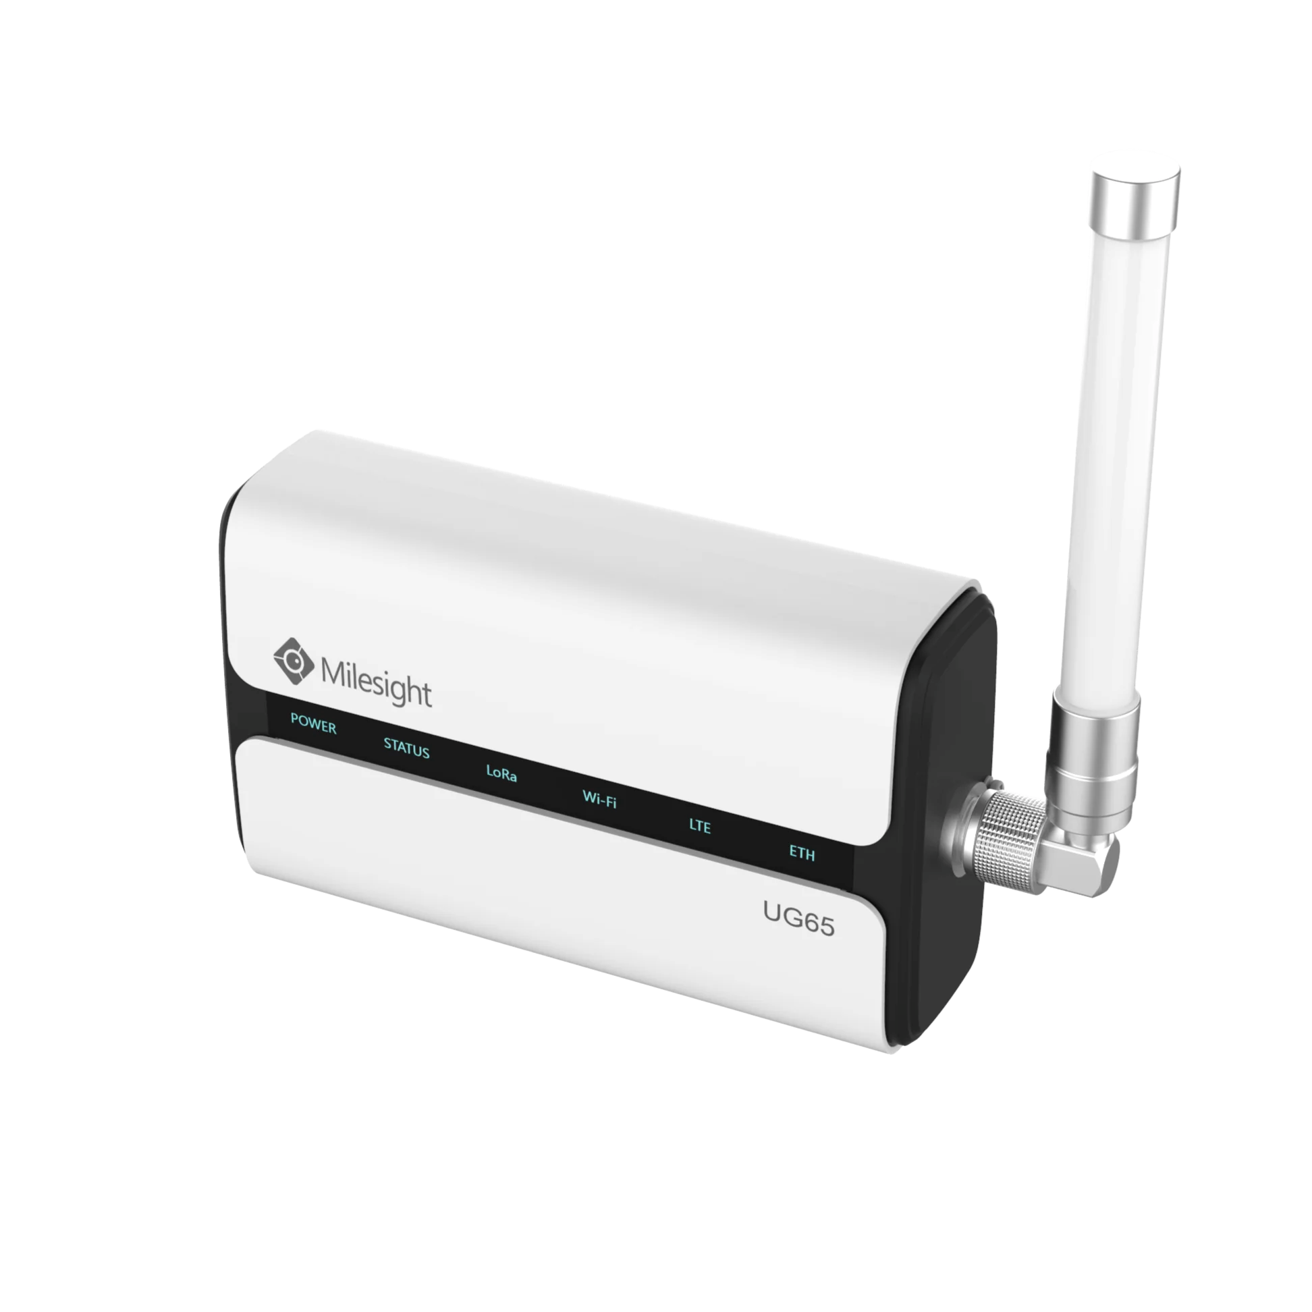
LoRaWAN (Cont’d)
Pros and Cons
Company and Product example
Pros
Long range: multiple kilometers
Low power: can last years on battery
Low cost: less than 20 euros (~$30 CAD)
Low bandwidth: 902-928 MHz
Able to create own gateways
Cons
Low data throughput
Struggles with large files
Gateway placement dependant
Requires network server and good coverage
Company: Milesight
Product: Milesight UG65 LoRaWAN Gateway
  Recives messages from LoRaWAN devices
  Forwards data to a network server through IP connection
  Provides bridge between sensor networks and IoT applications

Slide 9
LiDAR
Definition
Architecture and Design
Light Detection and Ranging: Remote-sensing method that uses laser beams to measure precise distances and movement in real time
Laser hits an object
Sensor detects this
Processor calculates the distance
Multiple rounds of this creates a 3D point cloud
Main Components
Applications
Laser scanner: emits rapid pulses of near-infrared laser light
LiDAR sensor: Detects and collects returning light pulses
Processor: Calculates the time and distance + building resultant data set, aka LiDAR point cloud
Agriculture
Aerospace and Defense
Automotive
Aviation

Slide 10
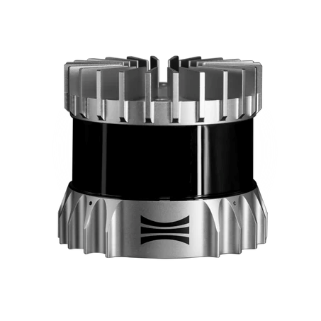
LiDAR (Cont’d)
Pros and Cons
Company and Product example
Pros
Accurate distance measurements
Detailed 3D environmental data
Useful for mapping and obstacle detection
Can operate in low-light conditions
Cons
Can be expensive
Fog, heavy rain, dust, and obstructions can affect measurements
Requires processing power and calibration
Sensing technology rather than a wireless communication protocol
Company: Ouster
Product: OS0 liDAR
  Ultra-wide field of view
  Produces 3D point-cloud data
  Designed for short-range perception
  Used in Robotics and industrial automation

Slide 11
Li-Fi
Definition
Architecture and Design
Light Fidelity: Wireless networking technology that uses light to transmit data and provide network connectivity
Star / Peer-to-Peer Topology
Compliments with Wi-Fi / Cellular network
Data is encoded into raplidly changing light signals
Main Components
Applications
Data Source
LED transmitter
Light communication channel
Photodetector
Indoor office networking
Hospitals
Secure indoor wireless communications
High-density wireless connectivity

Slide 12
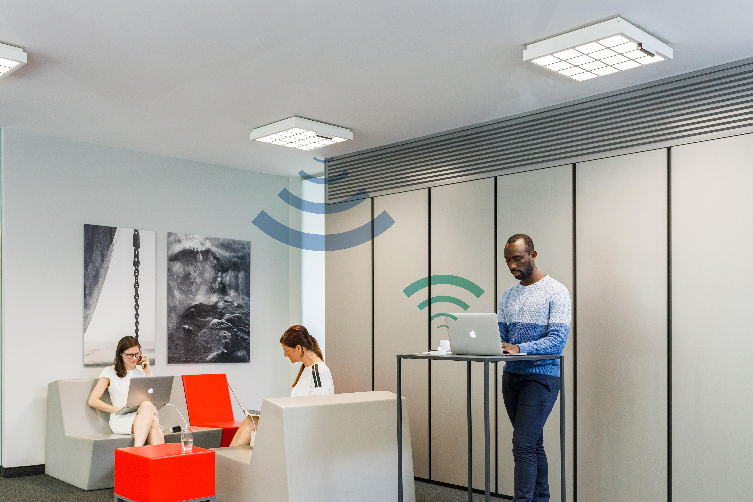
Li-Fi (Cont’d)
Pros and Cons
Company and Product example
Pros
High Data Transfer Rates
Enhanced Security
Energy Efficiency
Reduces Radio Frequency Congestion
Cons
Limited Range
Outdoor Limitations
Limited Usability in Darkness
Company: Signify
Product: Trulifi
  Provides optical wireless connectivity
  Designed for professional indoor environments
  Supports data transmission using light-based communication
  Can complement conventional wireless networks

Slide 13
Li-Fi

Slide 14
VLC

Slide 15
NB-IoT

Slide 16
LTE

Slide 17
5G

Slide 18
Add a Slide Title - 3

Slide 19
Reference
ZigBee
Z-Wave
https://homey.app/en-ca/wiki/what-is-z-wave/
LoRaWAN
https://www.thethingsnetwork.org/docs/lorawan/what-is-lorawan/
LiDAR
https://www.ibm.com/think/topics/lidar

Slide 20
Add a Slide Title - 4

Slide 21
Add a Slide Title - 5

